Slide 1
FINANCIAL ANALYTICS
YASH CHAUDHARY

Slide 2
DATA CLEANING
Preliminary data cleaning was conducted using Microsoft Excel
Fixed column names in snake format
Used sorting and filtering to look up empty and NaN values
Removed all rows with Nan and empty values
Did not treat for outliers due to nature of data.

Slide 3
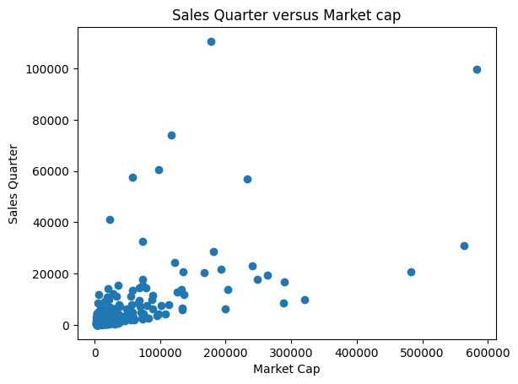
DATA EXPLORATION
𑁋Basic packages and modules
were imported.
𑁋Used basic functions like describe(), info(), shape to study the structure of the dataset

Slide 4
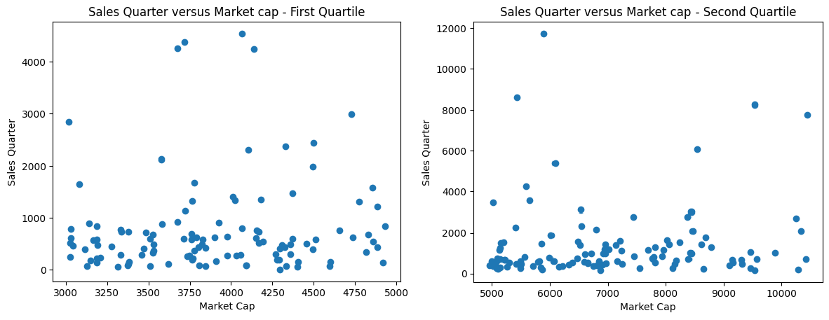
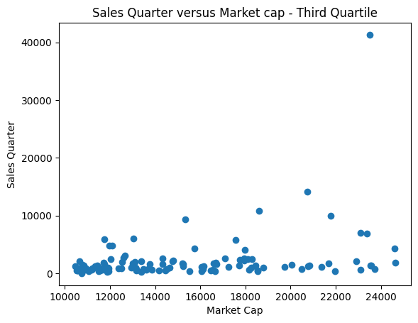
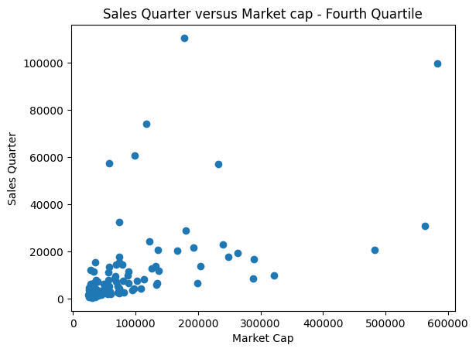
DATA EXPLORATION
𑁋To study the dataset, the dataframe was split up into 4 quartiles, and similar plots were plotted.
𑁋A linear relationship can be observed in plot 1, 2
and 3.

Slide 5
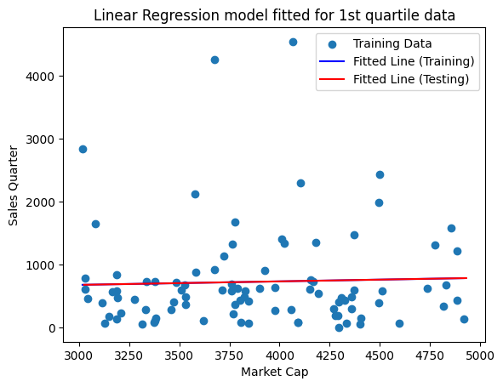
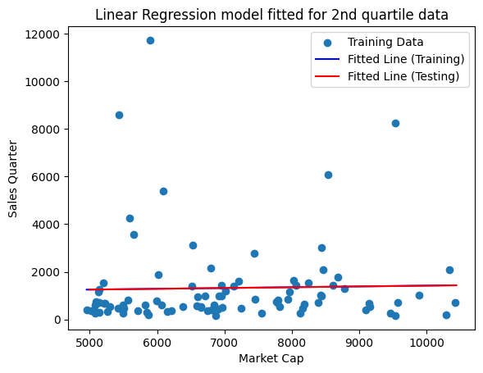
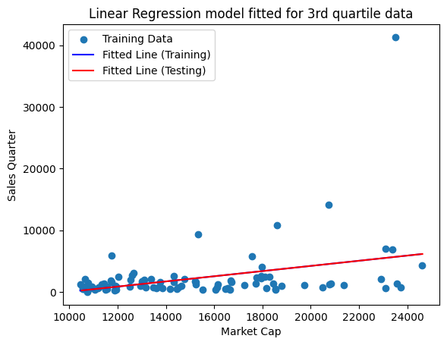
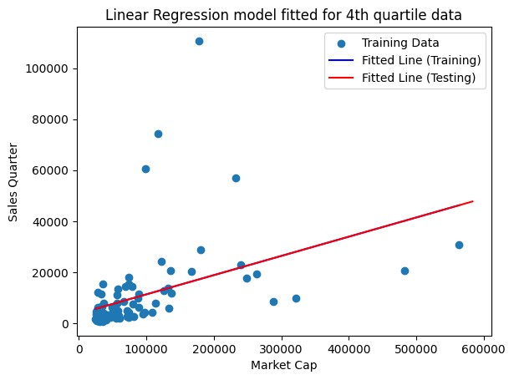
REGRESSION
𑁋Linear regression models were fit for all 4 quartiles separately, and yielded a good fit
𑁋However, the 3rd quartile has a negative intercept which could have been avoided using outlier elimination
𑁋Outlier elimination was not conducted because of nature of data.

Slide 6
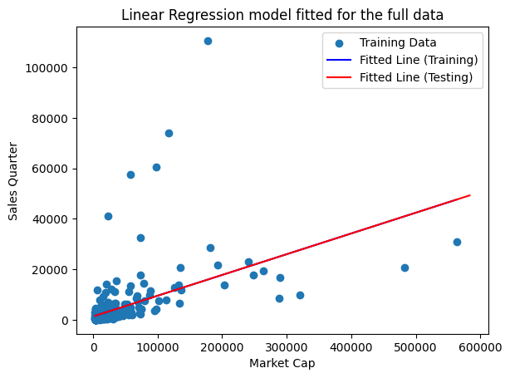
REGRESSION
𑁋This plot shows the linear regression model fit for the whole data.
𑁋As we can see, we cannot draw much inferences due to the high density of points on the lower left corner.

Slide 7
CONCLUSION
Preliminary data cleaning was conducted using Microsoft Excel
Structure of data was explored using basic
functions
Linear regression model was fit on whole data as well as the four quartiles
Outlier elimination could give better results, but
its not advisable to do so in financial data.

Slide 8
THANK YOU

